Slide 1
Front
Brenda
Heidi
Jessica
Jessie
Nicole
Linus
Steven
Waitlisted/
Auditors

Slide 2
Welcome to Web Design DeCal
Week 0

Slide 3

400+ applications
Notes:
CLAPs

Slide 4

wdd staff @ all of u

Slide 5
A few questions for you...
Notes:
Questions: By show of hands…
“How many of you are not CS majors”
“How many of you have no web design experience”
“How many of you are freshmen… sophomores… juniors… seniors”

Slide 6
Why you should be excited for this semester?

Slide 7

We're giving you the tools to create...

Slide 8
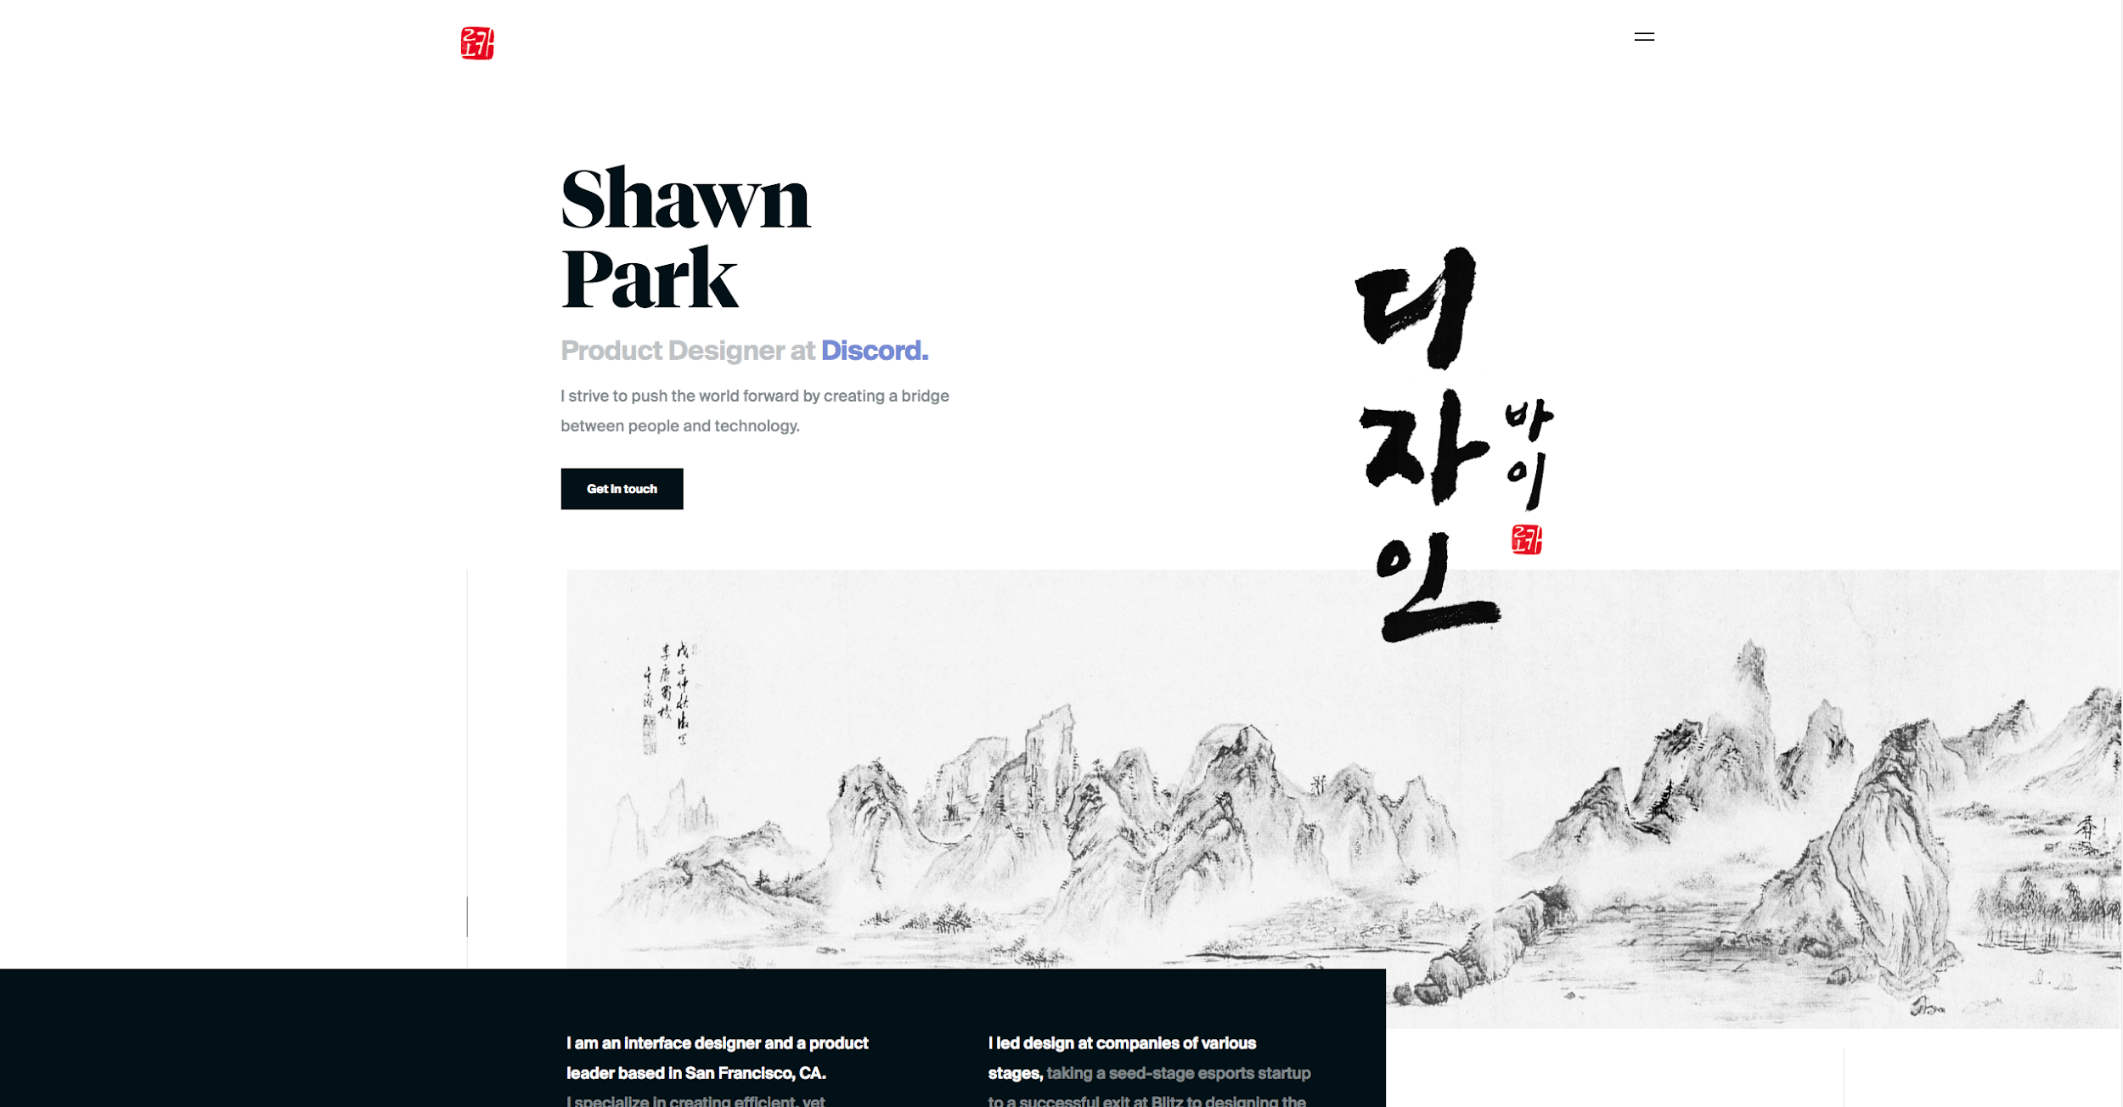
Some amazing things.
Some amazing things.
Notes:
Click on links, wow so pretty lol

Slide 9
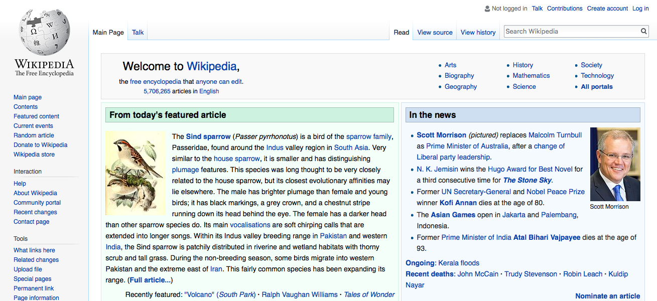
The Internet is a sea of information

Slide 10
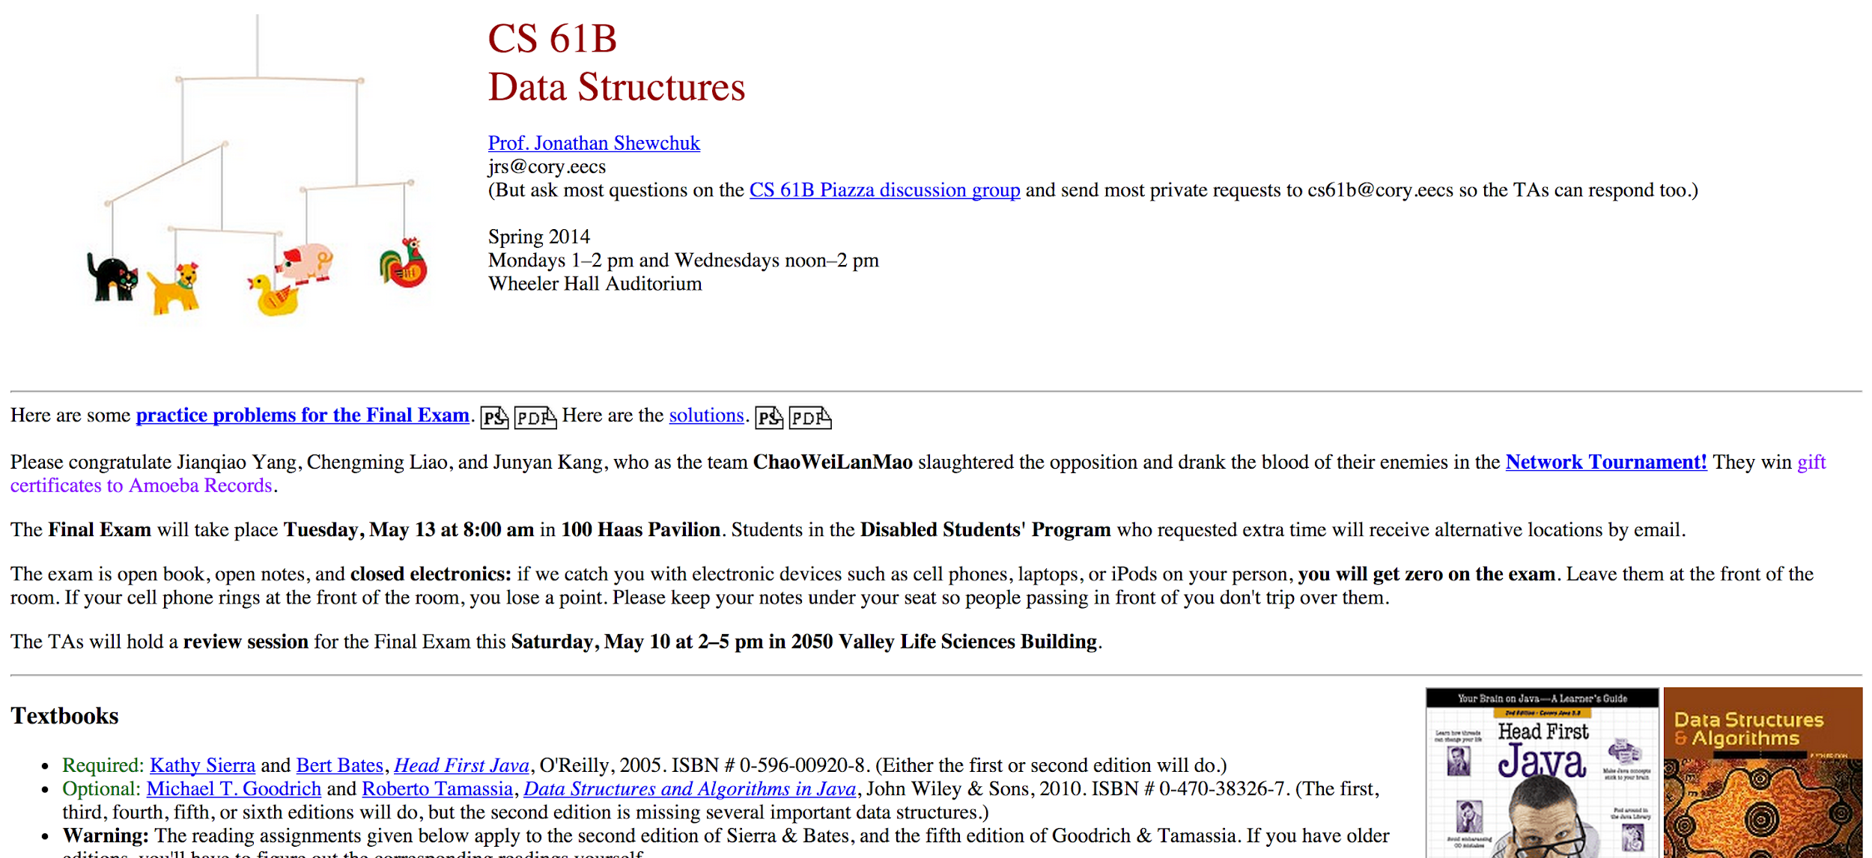
You’ll be able to find your online identity and turn it from this . . .

Slide 11
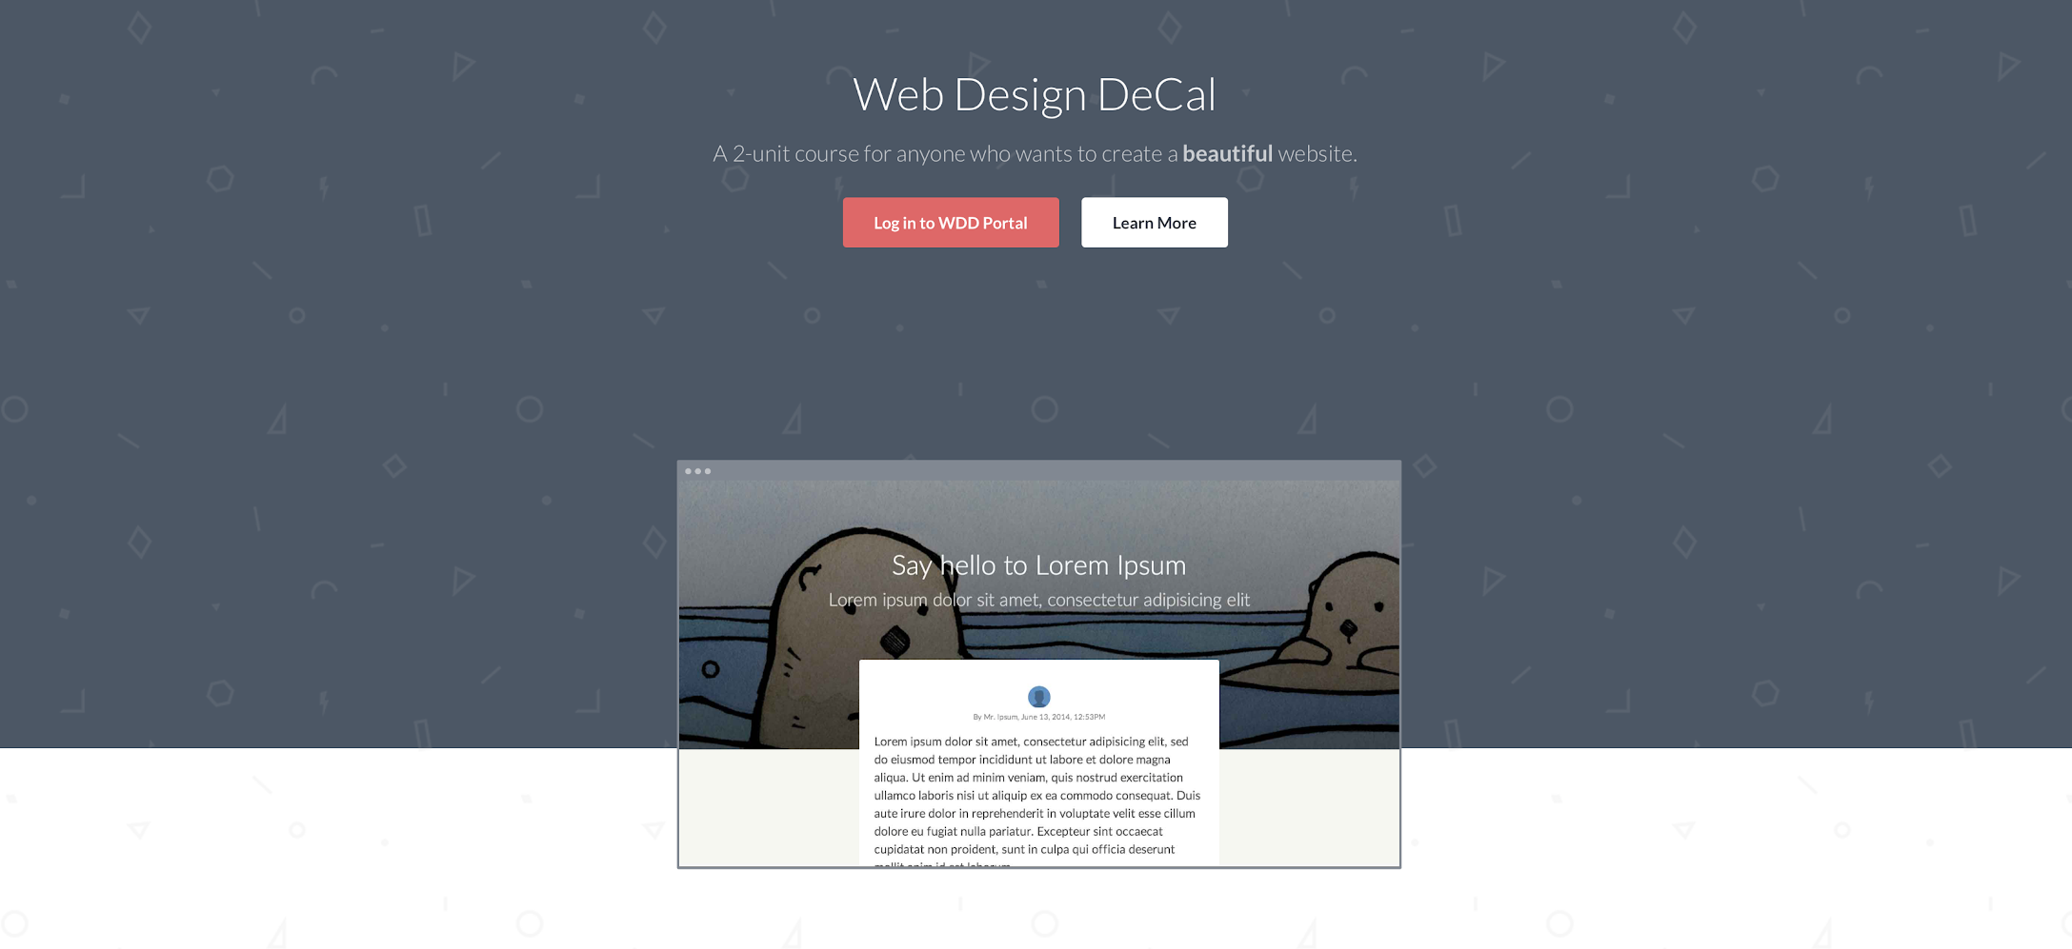
… to this! Learn how to make web beautiful!

Slide 12
Student examples
bit.ly/wddshowcase

Slide 13
What you'll learn in class

Slide 14
Programming section
Week 1
HTML
Week 2 - 5
CSS
Week 6 - 11
jQuery/JS

Slide 15
Design section
Week 1
Introduction
Week 2 - 6
UI Aesthetics
Week 7 - 11
User Experience

Slide 16
Confidence to CODE.
Confidence to DESIGN.
Confidence to CREATE.

Slide 17
Who are we?

Slide 18








Jemma Kwak
berkeley innovation design
Junior, Psychology
occasional normie meme maker
been here for a while tbh
going pescatarian
currently enrolled in eight classes rn
interested in design???

Slide 19
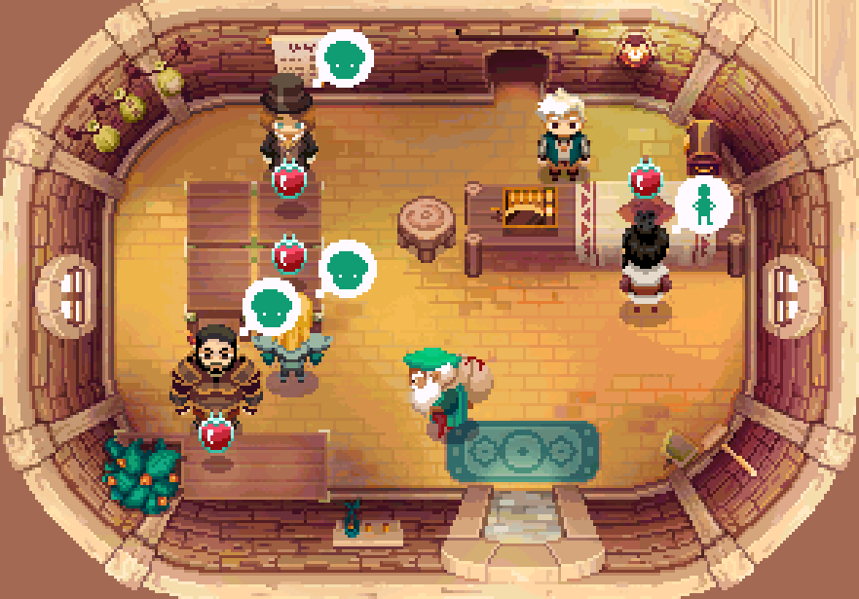

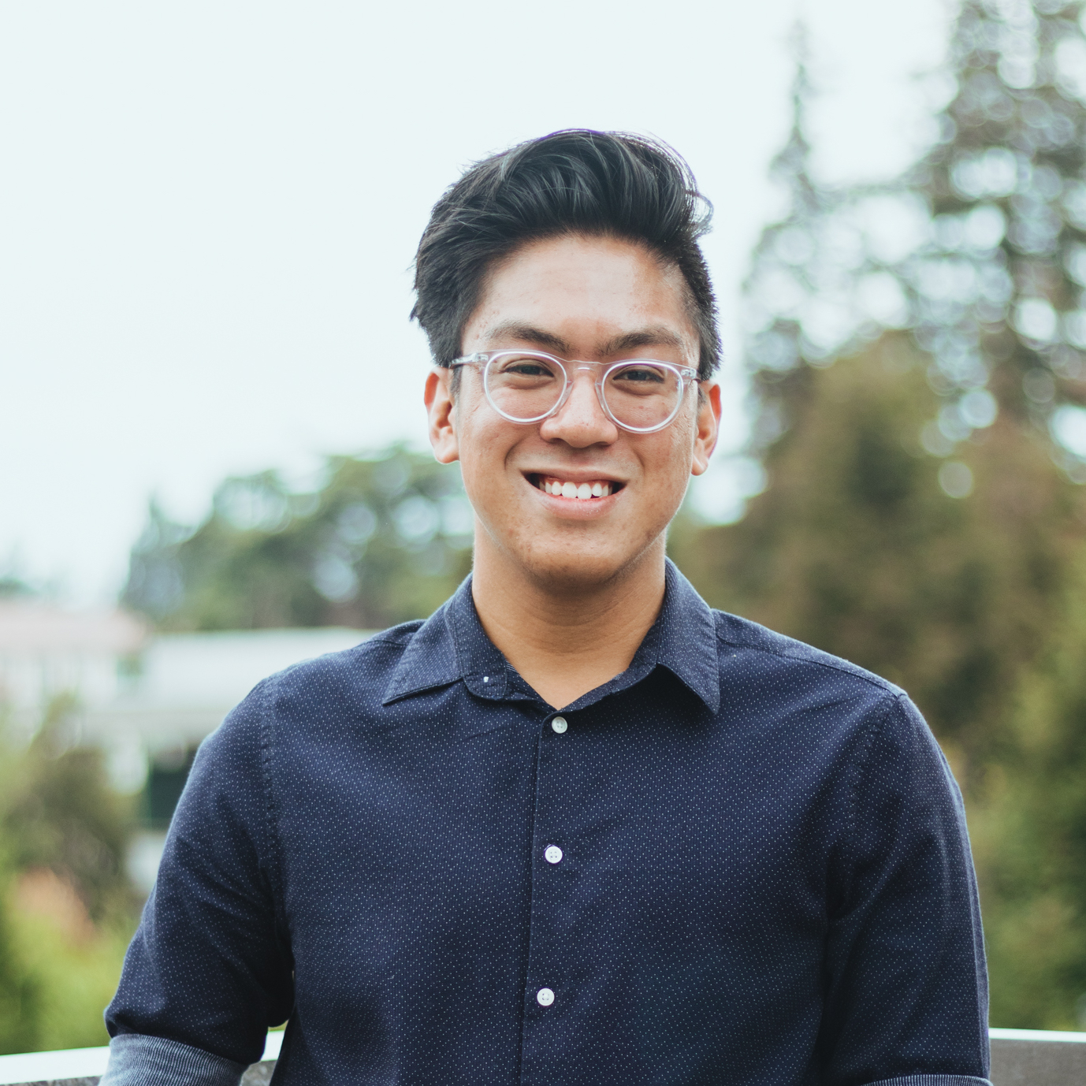

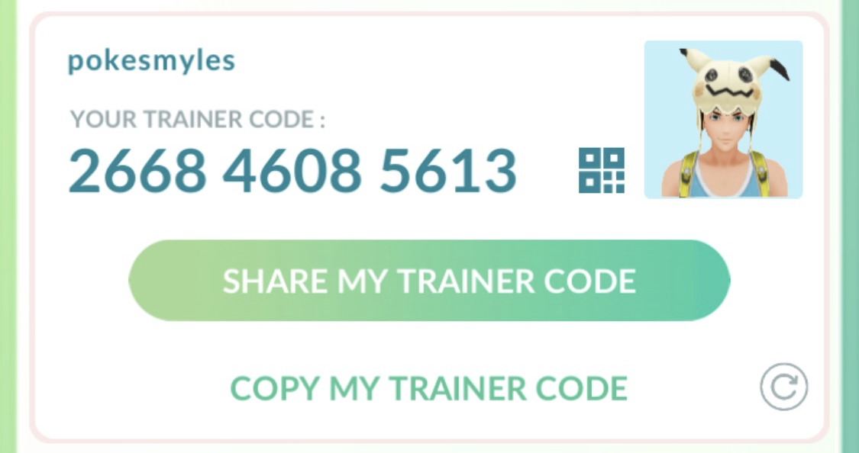



Myles Domingo
lofi trash
Sophomore, Computer Science
typical asian cs boi that plays video games and watches anime
but is willing to change Spring 2019
but only after you add me on LinkedIn
i know some of you out there in the audience its awkward please come say hi you can’t hide from me forever

Slide 20
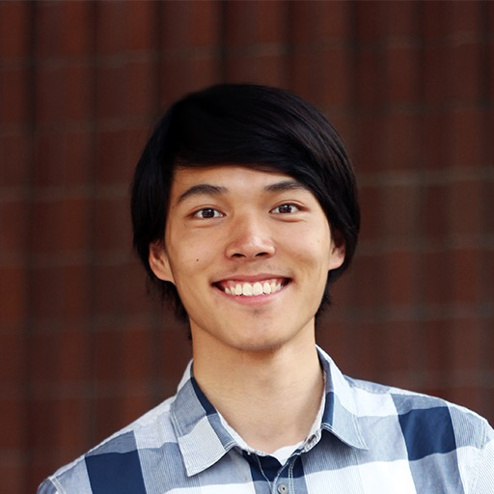










Seth Lu
Junior, Computer Science
watch musicals, movies; enjoy the outdoors
once read The Shining

Slide 21
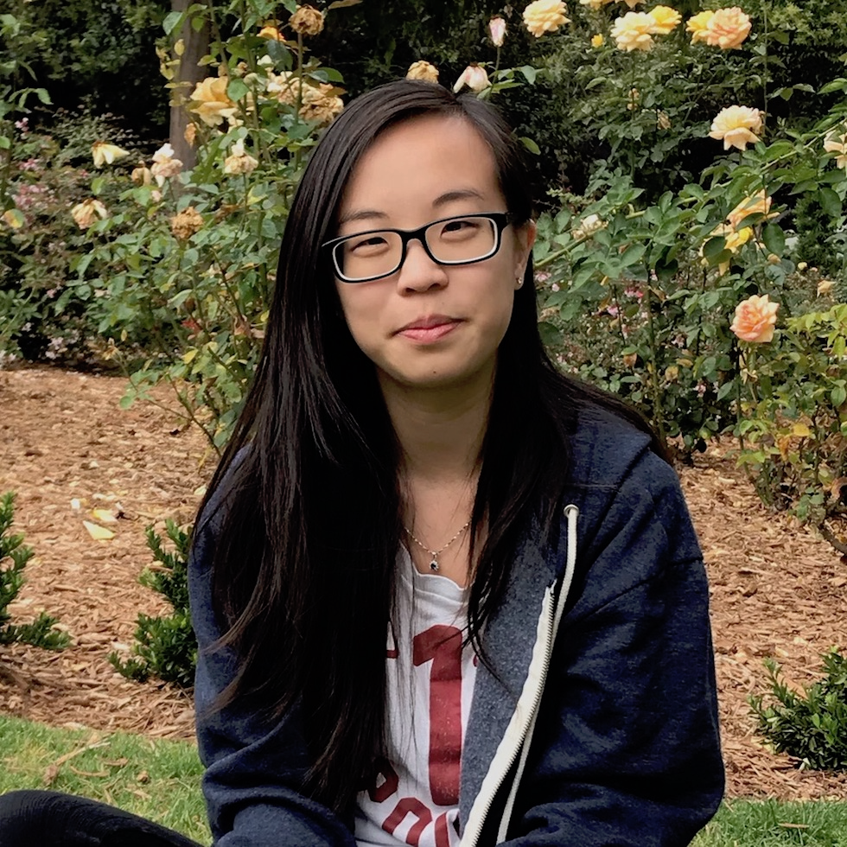

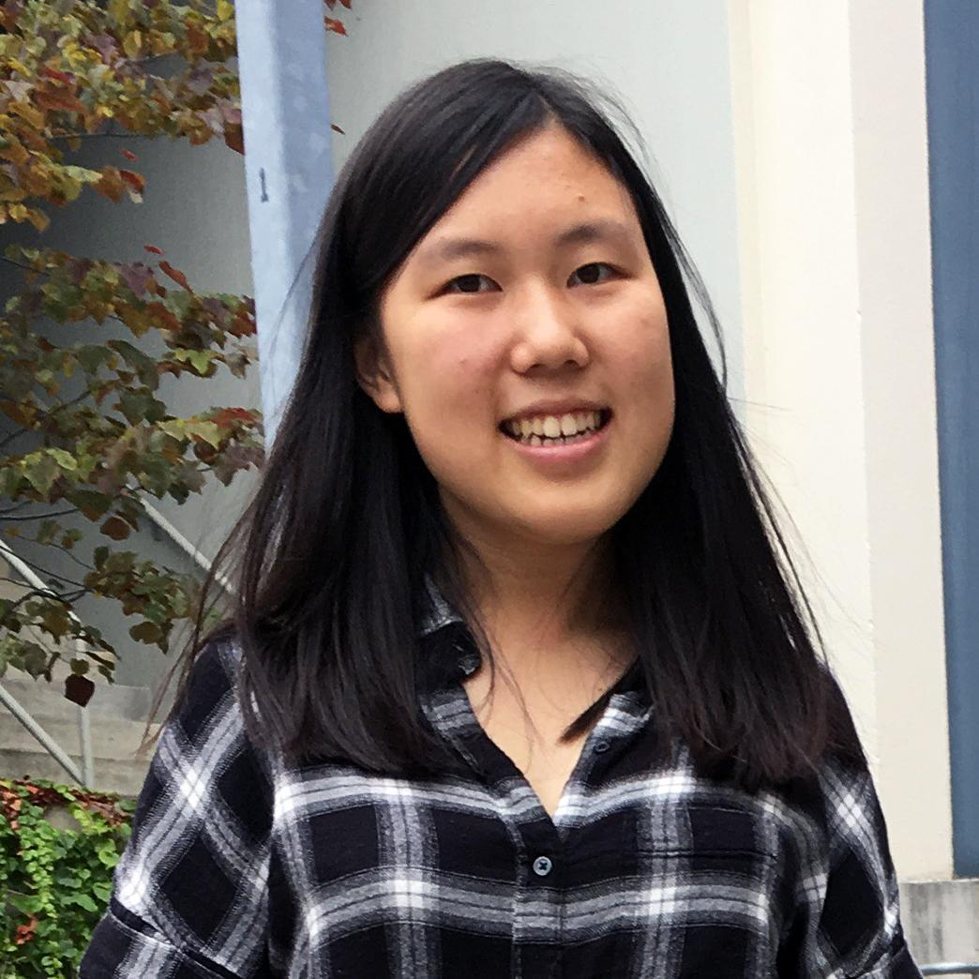
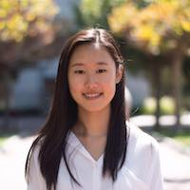
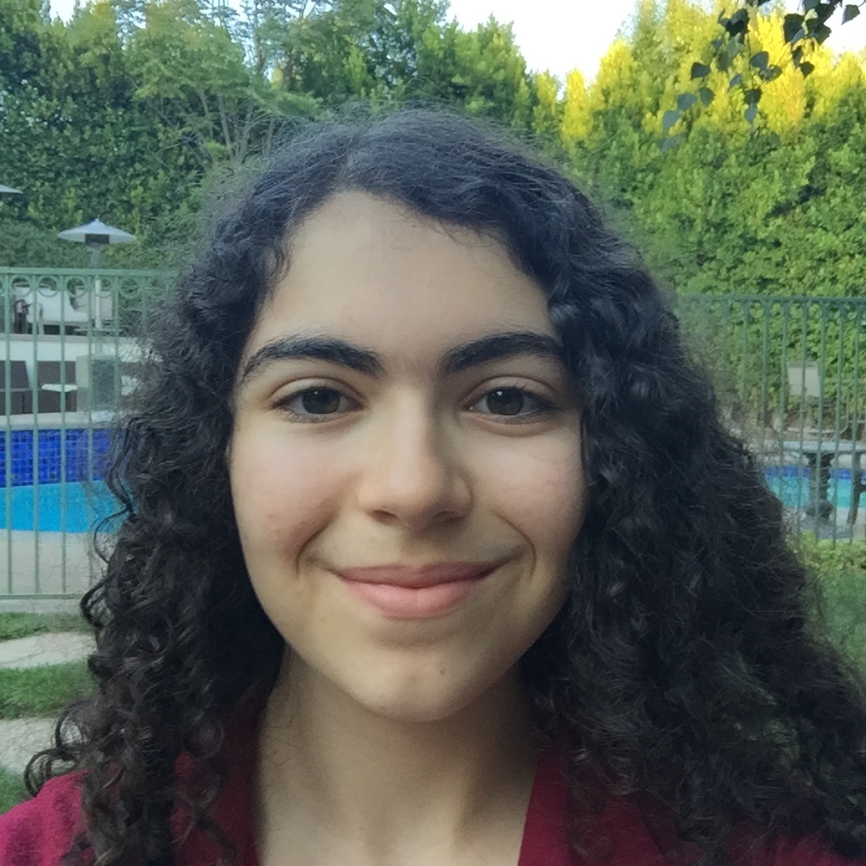

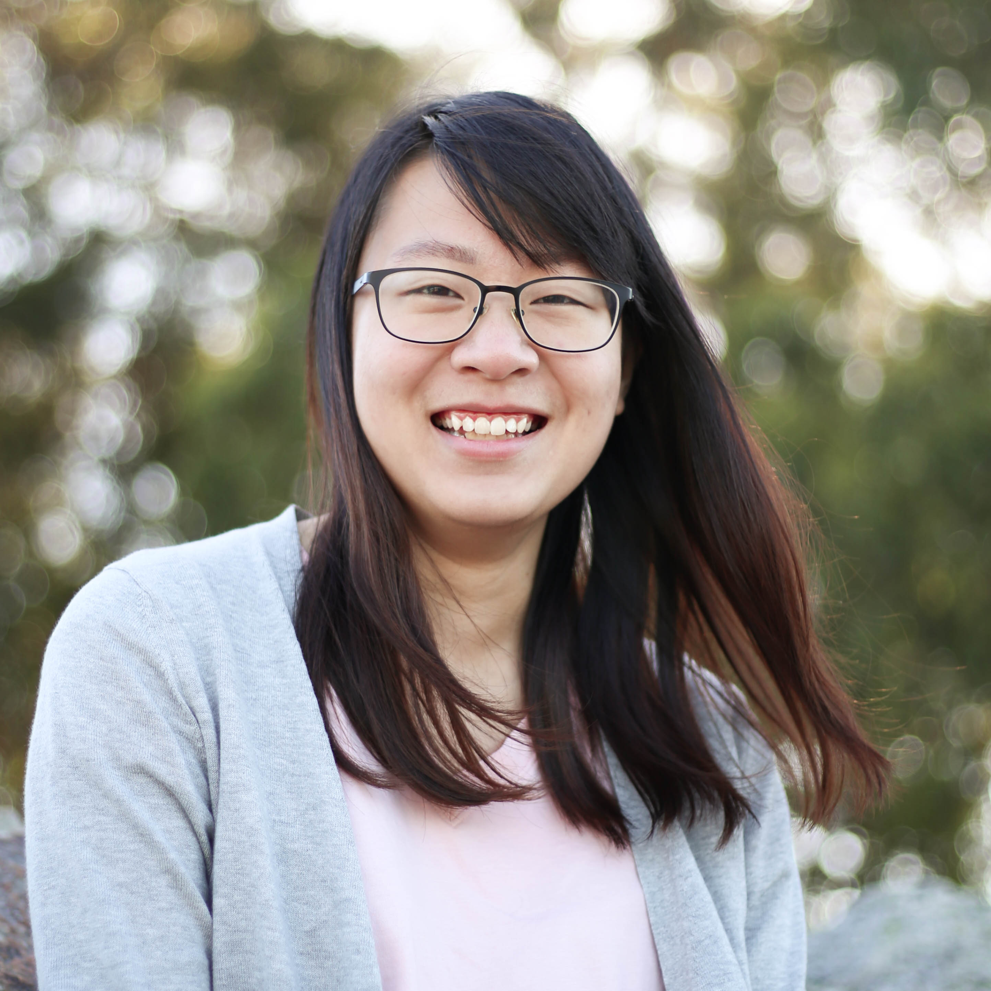
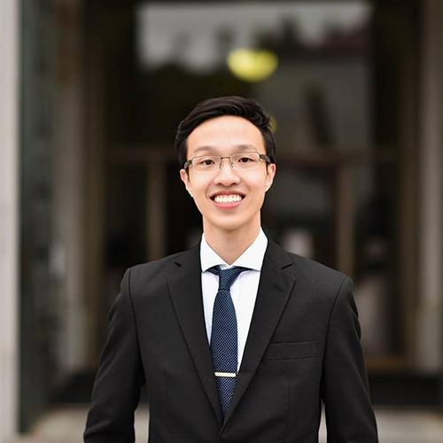
Our amazing teaching staff!
Brenda Zhang
Diana Fan
Heidi Dong
Jessica Chen
Jessie Mindel
Linus Lee
Nicole Chen
Steven Singorahardjo
Notes:
TA’s spend a little bit of time introducing themselves and their role in WDD
Year, major, semesters taking/on staff in WDD, (fun fact?)

Slide 22









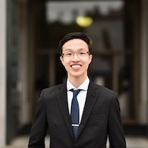

Slide 23
Icebreaker
Meet your groups!
Notes:
Ice breaker for ~10 min, make sure to sign everyone up and enroll them for the class, also creating accounts for the class

Slide 24
Course logistics
Monday 7–8:30pm & Wednesday 7–8pm @ 310 Jacobs
Monday: Lecture (NOT OPTIONAL)
(Mostly) split into a design and a programming lecture
Wednesday: Hands-on/Lab (NOT OPTIONAL)
(Mostly) activities like building websites, design sprints, etc.
Homework due (usually) every week, Monday 7pm
2 Units DeCal: P/NP

Slide 25
Course logistics (cont'd)
Late Homework? 50% off (but you have 2 free lowest HW drops)
Absences?
We allow 3 absences
Each absence after 3 absences is -5 points
Dropping the course?
Please fill out wdd.io/go/drop to let us know, so we can let people off the waitlist as well

Slide 26
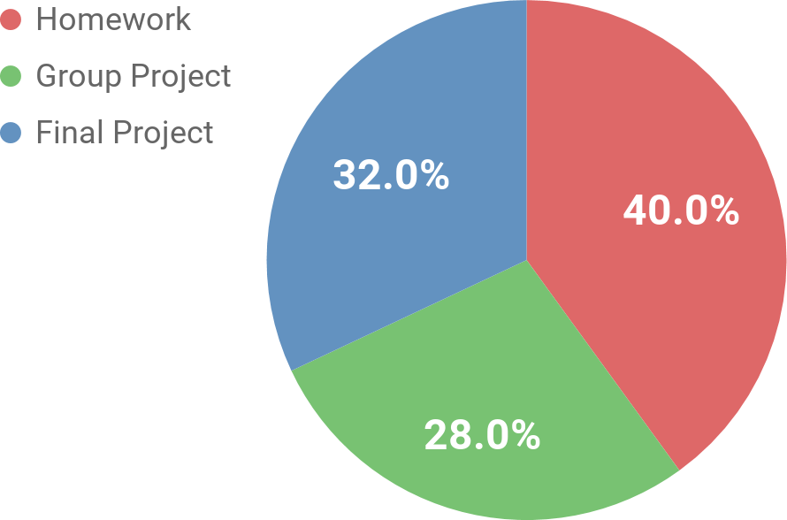
Grading
There are 100 points.
You must earn above 70 in order to pass.
You have 3 allowed absences, and each unexcused absence or absence over the limit of 3 will result in -5 points.

Slide 27
WDD Portal
Our own mini bCourses:
Access lecture slides, hands-ons, etc.
View and submit homework assignments
View grades
Attendance check-ins
In class Q&A queue
Enrollment for students:
Uncheck “Are you an auditor?”, then type in the course number

Slide 28

Sign up for our Piazza
piazza.com/berkeley/spring2019/desinv198
If you haven’t taken a CS class before, this is our main forum for discussion to ask questions about assignments, as well as our main form for announcements. Always remember to keep an eye out!

Slide 29
Piazza Etiquette and Office Hours
Ask questions on Piazza
DES INV 198: Web Design DeCal
Post screenshots of the web page so we can understand your problem better
If you have screenshots or snippets of actual code, please post it privately (instructors only)
Office hours (yes, office hours for a DeCal)
Almost every day! Add it to your calendar: wdd.io/go/OH

Slide 30

Anonymous feedback
wdd.io/go/feedback
Tell us anything you think that's good/bad with the course
(yes, we check this daily)

Slide 31
Ethics Only scary if you’re unethical.
Notes:
Emily start

Slide 32
Ethics Ethics Ethics
Certain resources are completely prohibited:
Twitter Bootstrap
Foundation
Semantic UI
… or any other HTML template site

Slide 33
Ethics Ethics Ethics
Homework
No outside resources allowed
Projects
No HTML/CSS resources allowed
Yes, JavaScript plugins allowed (more on this later)

Slide 34
Ethics Ethics Ethics
Consider the following case studies:
Person A copy-pastes sections of code from a website
No good
Person B has some experience and submitted a website B created before the class
No good
Person C writes the front end code from scratch and submits C's own work
Yes good

Slide 35
Ethics Ethics Ethics
Punishments for no good
We have no choice but to fail you in the course and report you to Student Conduct. We don’t want to be mean :(
"Plagiarism is defined as use of intellectual material produced by another person without acknowledging its source, for example: Wholesale copying of passages from works of others into your homework, essay, term paper, or dissertation without acknowledgment. Use of views, opinions, or insights of another without acknowledgment. Paraphrasing of another person's characteristic or original phraseology, metaphor, or other literary device without acknowledgment."

Slide 36
Questions?

Slide 37
Quick poll
Quick Intro to Websites
or
Enrollment on CalCentral & Portal?

Slide 38
Quick intro to websites, time permitting

Slide 39
What is a website?
A website is traditionally a set of web pages served on a single domain
A web page is a document, usually written in HTML
A domain is an address (wdd.io) that represents a server where the files are located

Slide 40
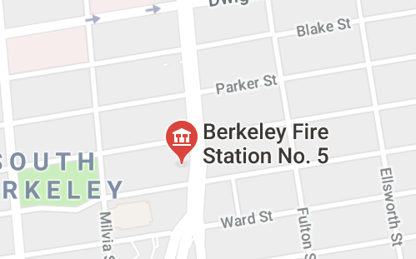
"Fire station"
2680 Shattuck Ave, Berkeley, CA 94704
Look up the address

Slide 41
207.38.86.245
Look up the address

Slide 42
<!DOCTYPE html PUBLIC "-//W3C//DTD XHTML 1.0 Transitional//EN""http://www.w3.org/TR/xhtml1/DTD/xhtml1-transitional.dtd">
<html xmlns="http://www.w3.org/1999/xhtml" xml:lang="en" lang="en">
<head>
<title>Web Design DeCal</title>
<meta name="description" content="A 2 unit course in UC Berkeley for anyone who wants to create a beautiful website." />
<meta property="og:title" content="Web Design DeCal" />
<meta property="og:url" content="http://www.wdd.io/" />
<meta property="og:image" content="http://www.wdd.io/static/thumbnails/logo.png" />
<meta property="og:description" content="A 2 unit course in UC Berkeley for anyone who wants to create a beautiful website." />
<meta property="og:site_name" content="Web Design DeCal" />
<meta name="twitter:title" content="Web Design DeCal">
<meta name="twitter:description" content="A 2 unit course in UC Berkeley for anyone who wants to create a beautiful website.">
<meta name="twitter:image" content="http://www.wdd.io/static/thumbnails/logo.png">
<link href='http://fonts.googleapis.com/css?family=Lato:300,400,700' rel='stylesheet' type='text/css'>
<link rel="stylesheet" type="text/css" href="/static/css/promotional.css" />
<link rel="shortcut icon" href="/static/icons/favicon.ico" />
<script type="text/javascript" src="/static/js/vendor/jquery-1.8.3.min.js" charset="utf-8"></script>
<script type="text/javascript" src="/static/js/vendor/jquery-ui-1.9.2.min.js" charset="utf-8"></script>
Fetch the file

Slide 43
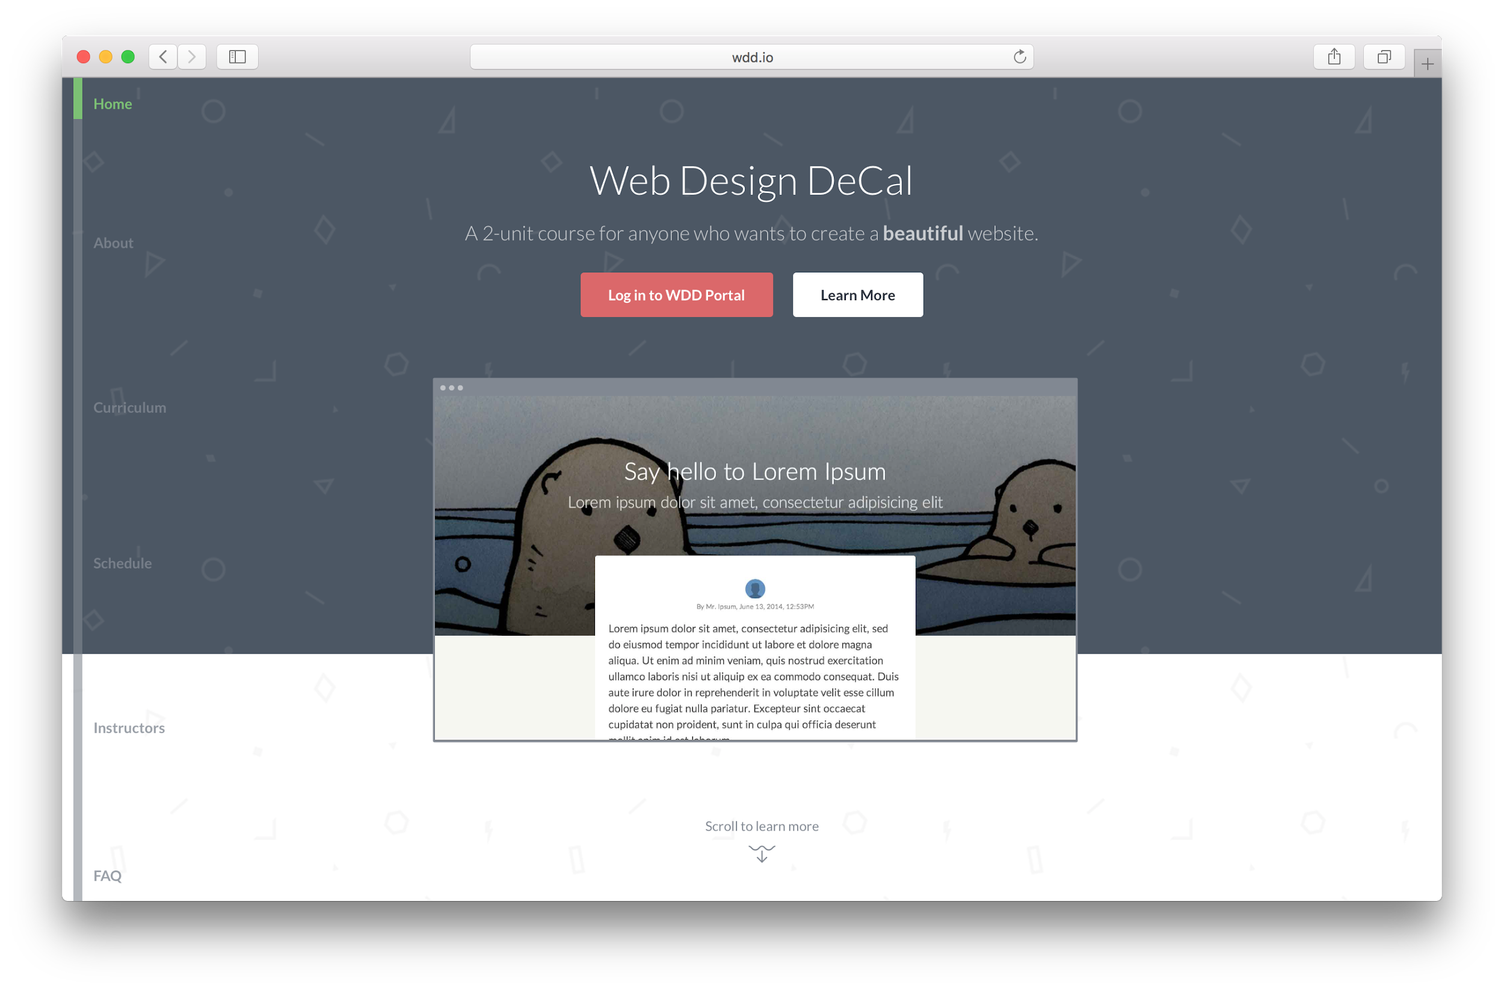
Render code on canvas

Slide 44
Two ends of a website (roughly speaking)
Front end
What users can see &
what happens in your web browser
e.g. text, images, buttons
Back end
What users can't see &
beyond your web browser
e.g. business logic, data storage

Slide 45
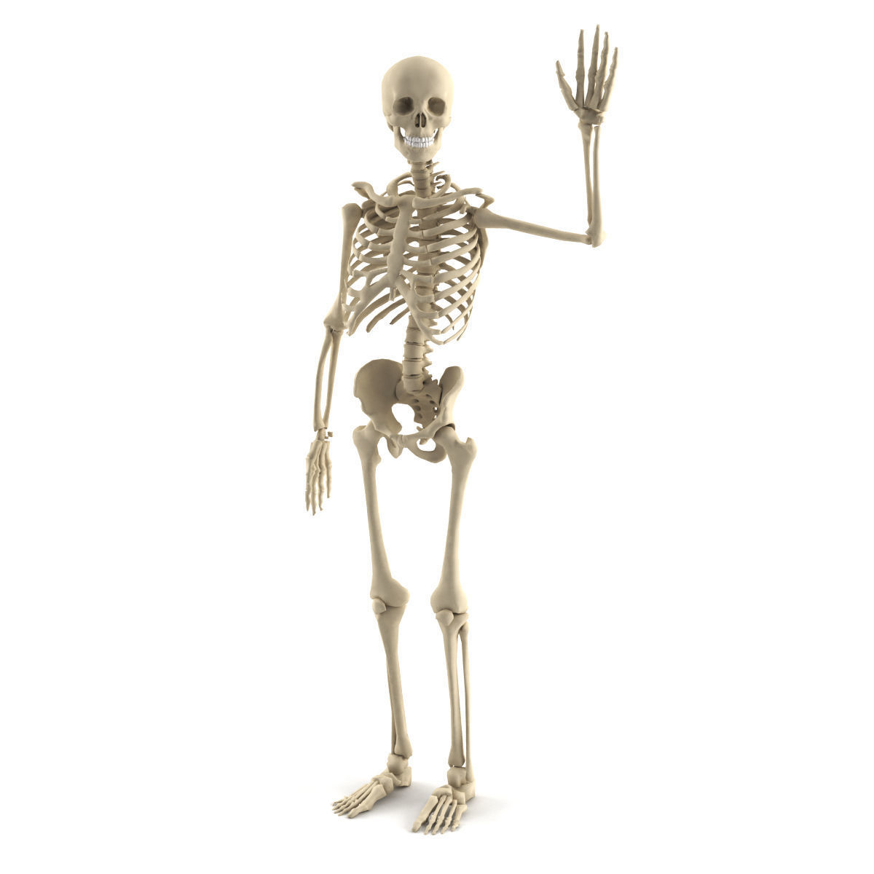


What websites are made of
HTML
Structure
CSS
Design
JavaScript
Function

Slide 46
HTML provides the structure of the page
A well-written HTML document should be "understandable" without a stylesheet

Slide 47
<!DOCTYPE html PUBLIC "-//W3C//DTD XHTML 1.0 Transitional//EN""http://www.w3.org/TR/xhtml1/DTD/xhtml1-transitional.dtd">
<html xmlns="http://www.w3.org/1999/xhtml" xml:lang="en" lang="en">
<head>
<title>Web Design DeCal</title>
<meta name="description" content="A 2 unit course in UC Berkeley for anyone who wants to create a beautiful website." />
<meta property="og:title" content="Web Design DeCal" />
<meta property="og:url" content="http://www.wdd.io/" />
<meta property="og:image" content="http://www.wdd.io/static/thumbnails/logo.png" />
<meta property="og:description" content="A 2 unit course in UC Berkeley for anyone who wants to create a beautiful website." />
<meta property="og:site_name" content="Web Design DeCal" />
<meta name="twitter:title" content="Web Design DeCal">
<meta name="twitter:description" content="A 2 unit course in UC Berkeley for anyone who wants to create a beautiful website.">
<meta name="twitter:image" content="http://www.wdd.io/static/thumbnails/logo.png">
<link href='http://fonts.googleapis.com/css?family=Lato:300,400,700' rel='stylesheet' type='text/css'>
<link rel="stylesheet" type="text/css" href="/static/css/promotional.css" />
<link rel="shortcut icon" href="/static/icons/favicon.ico" />
<script type="text/javascript" src="/static/js/vendor/jquery-1.8.3.min.js" charset="utf-8"></script>
<script type="text/javascript" src="/static/js/vendor/jquery-ui-1.9.2.min.js" charset="utf-8"></script>
HTML example from wdd.io

Slide 48
CSS provides the design of the page
Just several lines of "code" is enough to create "design" shapes, color, buttons, you name it

Slide 49
body {
margin: 0;
font-family: 'Lato', sans-serif;
background: #f7f5f2;
-webkit-font-smoothing: antialiased;
}
a {
color: inherit;
text-decoration: none;
}
.img-scaled {
width: 100%;
}
.img-scaled-wh {
width: 100%;
height: 100%;
object-fit: cover;
}
.clear {
clear: both;
CSS example from wdd.io

Slide 50
JavaScript provides the function of the page
What will happen to websites with JavaScript disabled?

Slide 51
function resize_dom(window_height) {
$('.schedule-item')
.css('padding-top', (($(window).height() - window_height) / 2) + 'px');
$('.schedule-item:nth-child(12)')
.css('padding-bottom', (($(window).height() - window_height) / 2) + 'px');
$('#apply-header').css('height', $(window).height() - 180 + 'px');
setTimeout(function(){
scheduleOffsetDict = {};
$('.schedule-item').each(function(i){
scheduleOffsetDict[$(this).position().top - 120] = i;
});
}, 100);
}
function set_cover() {
var offsetY = $(window).height() * 0.7 - 340;
$('.window-container').css('top', offsetY);
}
$(document).ready(function(){
set_cover();
JavaScript example from wdd.io

Slide 52
Takeaway
HTML
Structure
CSS
Design
JavaScript
Function

Slide 53
Attendance Word: doner
CCN for Web Design DeCal: 33229
Please use the CCN when signing up on WDD portal: wdd.io
If you got a little too excited before class and signed up already, come find the co-instructors
Your TA will hand out your permission code
Have your ID's out!

Slide 54
Join the Spotify Playlist

